Slide 1
Software Engineering :
1 : Introduction
Professor Imed Bouchrika National School of Artificial Intelligence imed.bouchrika@ensia.edu.dz

Slide 2
Outline :
Writing a Program vs Software
Software Failures
Software Engineering
Process and Development Life Cycle
Principles of Software Engineering
Software Development Companies

Slide 3
Writing a Program vs Software
You are asked by a client to Write a “Program” to print “hello world” inside the console using the Java Programming Language.

Slide 4
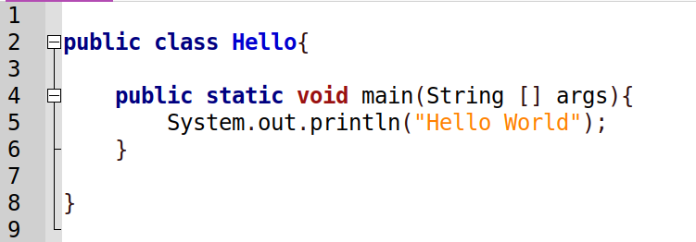
Writing a Program vs Software
You are asked by a client to Write a “Program” to print “hello world” inside the console using the Java Programming Language.
Java Development Kit ( JDK) must be installed
To compile : javac Hello.java To execute the code : java Hello

Slide 5
Writing a Program vs Software
Is this a good programming practice ?
You are asked by a client to Write a “Program” to print “hello world” inside the console using the Java Programming Language.

Slide 6
Writing a Program vs Software
Is this a good programming practice ?
Putting Business Logic inside the main procedure
No use of Object-Oriented Design
Inclusion of Text inside the code
No comments
No Abstraction
Not Modular
…
You are asked by a client to Write a “Program” to print “hello world” inside the console using the Java Programming Language.

Slide 7
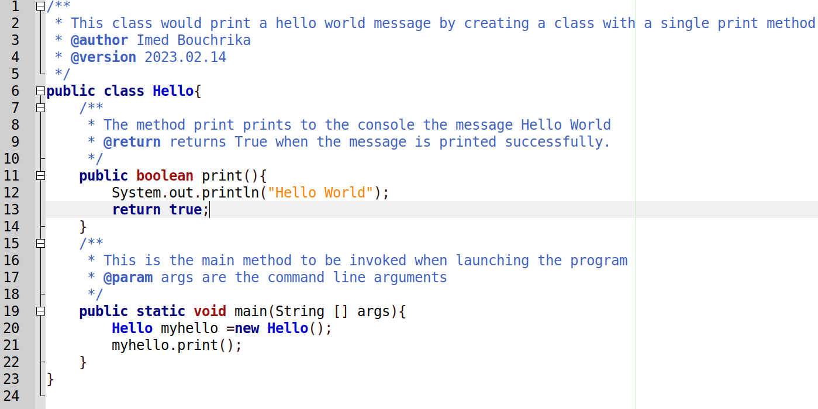
Writing a Program vs Software

Slide 8
Writing a Program vs Software
Is it easy to code and program ?
How much you charge the customer for it ?
Will you be ethically required to assist, train and support the customer ?
What if the customer would like to have the following changes:
“Hello World” to “Hello All”
…
Can you still maintain and work on the code after 10 years ?

Slide 9
Writing a Program vs Software
Is it easy to code and program ?
How much you charge the customer for it ?
Will you be ethically required to assist, train and support the customer ?
What if the customer would like to have the following changes:
“Hello World” to “Hello All”
…
Can you still maintain and work on the code after 10 years ?

Slide 10
Writing a Program vs Software
Is it easy to code and program ?
How much you charge the customer for it ?
Will you be ethically required to assist, train and support the customer ?
What if the customer would like to have the following changes:
“Hello World” to “Hello All”
…
Can you still maintain and work on the code after 10 years ?

Slide 11
Writing a Program vs Software
Is it easy to code and program ?
How much you charge the customer for it ?
Will you be ethically required to assist, train and support the customer ?
What if the customer would like to have the following changes:
“Hello World” to “Hello All”
…
Can you still maintain and work on the code after 10 years ?

Slide 12
Writing a Program vs Software
Is it easy to code and program ?
How much you charge the customer for it ?
Will you be ethically required to assist, train and support the customer ?
What if the customer would like to have the following changes:
“Hello World” to “Hello All”
…
Can you still maintain and work on the code after 10 years ?

Slide 13
Writing a Program vs Software
ad-hoc or programming-centered approach :
You write a computer program in an unplanned way to solve a particular problem
The main focus is made initially towards starting the programming task

Slide 14
Writing a Program vs Software
Computer Program:
Is a set of instructions written in a programming language after which it will be compiled or translated to the machine language to perform a specific task.
Is Computer program written in Java called a Software ?
Is : Computer Program = Software ?

Slide 15
Writing a Program vs Software
What’s Software :
Is not a computer program
Is the set of computer programs in addition to the associated documentation, configuration files and data

Slide 16
Writing a Program vs Software
What’s a Software Product
The product is an Industrial-strength software of high quality to solve some problem of some set of users

Slide 17
Writing a Program vs Software
What types of Software Products to develop
Generic Software Products
Standalone systems that are produced and sold on the open market to any customer.
This type of software includes “vertical” applications which are designed for a specific market such as “Accounting Systems,,,,”
Examples : mobile apps, website scripts, downloadable software..

Slide 18
Writing a Program vs Software
What types of Software Products to develop
Customized Software
These are systems which are commissioned and developed for a particular customer
Examples :
Control Systems for an Electronic devices
Software Systems to support particular business process for a company

Slide 19
Writing a Program vs Software
What if another customer wants to buy the same customized software ?
What type of Software Product to develop
Customized Software
These are systems which are commissioned and developed for a particular customer
Examples :
Control Systems for an Electronic devices
Software Systems to support particular business process for a company

Slide 20
Writing a Program vs Software
What type of Software Product to develop
Customized Software
These are systems which are commissioned and developed for a particular customer
Examples :
Control Systems for an Electronic devices
Software Systems to support particular business process for a company
What if another customer wants to buy the same customized software ? This depends on how you agreed with the customer on the ownership : Are you selling a copy or full and exclusive ownership of the software ?

Slide 21
Writing a Program vs Software
What types of Software Products to develop
Generic Software Products
Flexibility and Customization:
More generic software products are being developed with advanced features to be customizable to more scenarios using configuration options, plugins, extensions.…

Slide 22
Writing a Program vs Software
What types of Software Products to develop
Stand-alone applications :
These are application systems that run on a personal computer or apps that run on a mobile device. They include all necessary functionality and may not need to be connected to a network.
Examples : office applications on a PC, CAD programs, photo manipulation software, travel apps, productivity apps, and so on.

Slide 23
Writing a Program vs Software
What software products we can develop
Interactive transaction-based applications : These are applications that execute on a remote computer and that are accessed by users from their own computers, phones, or tablets.
Examples : web applications such as e-commerce applications, business systems accessible via browser or special client. Another example is cloud-based services, such as mail and photo sharing.

Slide 24
Writing a Program vs Software
What software products we can develop
Embedded control systems These are software control systems that control and manage hardware devices.
Numerically, there are probably more embedded systems than any other type of system.
Examples : software that controls antilock braking in a car, and software in a microwave oven to control the cooking process, lifts….

Slide 25
Writing a Program vs Software
What software products we can develop
Batch processing systems : These are business systems that are designed to process data in large batches. They process large numbers of individual inputs to create corresponding outputs.
Examples of batch systems are periodic billing systems, such as phone billing systems, and salary payment systems.

Slide 26
Writing a Program vs Software
What software products we can develop
Entertainment systems These are systems for personal use that are intended to entertain the user. The quality of the user interaction offered is the most important distinguishing characteristic of entertainment systems.
Examples : Gaming Systems

Slide 27
Writing a Program vs Software
What software products we can develop
Systems for modeling and simulation These are systems that are developed by scientists and engineers to model physical processes or situations, which include many separate, interacting objects. These are often computationally intensive and require high-performance parallel systems for execution.

Slide 28
Writing a Program vs Software
Characteristics of software in the modern era:
Scaling
The complexity and size of problem are increasing dramatically
Change
The need of customers change fast

Slide 29
Writing a Program vs Software
What are the qualities of good software product with industrial-strength
01
Correctness (Functionality) : The software meets the requirements and specifications that it was designed for, and it behaves as expected when it is used in its intended environment.
All functionalities are correctly implemented

Slide 30
Writing a Program vs Software
What are the qualities of good software product with industrial-strength
02
Usability and Acceptability : The software is easy to use and understand, and it provides a positive user experience.
Users should also accept and adopt the software product by continuing to use it

Slide 31
Writing a Program vs Software
What are the qualities of good software product with industrial-strength
03
Reliability : The software is free of defects and it performs consistently and accurately under different conditions and scenarios.

Slide 32
Writing a Program vs Software
What are the qualities of good software product with industrial-strength
04
Maintainability : The software is easy to change and update, and it is well-documented, so that it can be understood and modified by other developers.

Slide 33
Writing a Program vs Software
What are the qualities of good software product with industrial-strength
05
Security : The software is protected against unauthorized access and it keeps the data and functions safe from malicious attacks.

Slide 34
Writing a Program vs Software
What are the qualities of good software product with industrial-strength
06
Efficiency and Performance : The software runs efficiently and quickly, and it can handle large amounts of data or traffic.

Slide 35
Writing a Program vs Software
What are the qualities of good software product with industrial-strength
07
Scalability : The software can handle an increasing workload and it can be easily extended to meet the changing requirements.
Scaling to increase large number of users, big data or even larger spatial deployment

Slide 36
Writing a Program vs Software
What are the qualities of good software product with industrial-strength
08
Portability : the ease with which software can be used on computer or platform configurations other than its current one where it was developed and tested.

Slide 37
Writing a Program vs Software
What are the qualities of good software product with industrial-strength
09
Reusability and Openness : the ease with which software can be reused in developing other software.

Slide 38
Writing a Program vs Software
What are the qualities of good software product with industrial-strength
10
Adaptability and Flexibility: The software is flexible to be customized without extra development in order to adapt it to different future requirements.

Slide 39
Software Failures and Statistics
You will be primarily responsible for developing software
Will you succeed to create a software product with the attributes discussed ?
ZDNet reported in 2012:
“Worldwide cost of IT failure is $3 trillion”

Slide 40
Software Failures and Statistics
Chaos Report (1995) reported that
only about 16% of software projects are completed on-time, and within-budget
84% of projects failed!
Chaos Report (2009) stated that software projects :
32% completed, on-time, and within-budget.
68% of projects failure!

Slide 41
Software Failures and Statistics
Chaos Report (1995) reported that
only about 16% of software projects are completed on-time, and within-budget
84% of projects failed!
Chaos Report (2009) stated that software projects :
32% completed, on-time, and within-budget.
68% of projects failure!
Failed Software Projects : - Cancelled - Delivered Late - Run over their budget

Slide 42
Software Failures and Statistics
Example :
National programme for IT in the NHS (UK national health service) NPfIT:
Cancelled project took 9 years and cost £12 Billions
“The [UK] government will formally announce the scrapping of the National programme for IT in the NHS…to “urgently dismantle” the health service IT scheme comes after a series of damming reports…The final nail in the £12 billion scheme will be announced this morning…set up in 2002, is not fit to provide services to the NHS. ‘There can be no confidence that the programme has delivered or can be delivered as originally conceived,’”

Slide 43
Software Failures and Statistics
Main reasons of failures:
Increasing System Complexity :
Systems become larger with increased complexity
The demands and requirements change and increase dramatically
Failure to use Software Engineering Methods
It is easy to write the hello world program without the principles of software engineering. But within a budget can you : maintain it, evolve it and scale it ?

Slide 44
Software Failures and Statistics
Main reasons of failures:
Bad Management and Poor Leadership
Misuse of the resources / Budget
Lack of communication
Lack of motivation among the employees
Poor Planning
Incorrect Estimation of Budget
…

Slide 45
Software Engineering
The goal of software development is to develop
High quality software that meets customers’ real needs.
On time
On budget

Slide 46
Software Engineering
Definitions :
A discipline that integrates processes, methods and tools for the analysis, design, development, testing and maintenance of computer software products whilst complying with the set of conventional principles and best practices.
The term was coined in 1968 at a conference to discuss the software crisis

Slide 47
Software Engineering
Software Engineers
They make things work.
They apply theories, methods, and tools where these are appropriate. However, they use them selectively
Try to discover solutions to problems even when there are no applicable theories and methods.
Engineers also recognize that they must work within organizational and financial constraints, and they must look for solutions within these constraints.
All aspects of software production Software engineering is not just concerned
with the technical processes of software development. It also includes activities
such as software project management and the development of tools, methods,
and theories to support software development.

Slide 48
Software Engineering
Software Engineering
is not just concerned with the technical processes of software development.
It also includes activities such as software project management and the development of tools, methods, and theories to support software development.

Slide 49
Software Engineering
Why Software Engineering
Individuals and society rely on software systems. We need to be able to produce reliable and trustworthy systems economically and quickly
It is usually cheaper, in the long run, to use software engineering methods and techniques for professional software systems rather than just write programs as a personal programming project.
Failure to use software engineering method leads to higher costs for testing, quality assurance, and long-term maintenance.

Slide 50
Software Development Life Cycle
To develop a Software for the “Hello World”
Understand the problem
Perform some design and planning
Code and Develop the Software
Validate and test the software
Release, Install, Run or Deploy the software for the client
Maintenance and Support

Slide 51
Software Development Life Cycle
To develop a Software for the “Hello World”
Requirement Analysis : Understand the problem
Design : Perform some design and planning
Implementation : Code and Develop the Software
Testing : Validate and test the software
Integration : Release, Install, Run or Deploy the software for the client
Maintenance : Maintenance and Support

Slide 52
Software Development Life Cycle
Ideal Process :
Design and Planning
Implementation
Requirement Analysis
Maintenance
Testing
Integration

Slide 53
Software Development Life Cycle
Process in Reality :
Design and Planning
Implementation
Requirement Analysis
Maintenance
Testing
Integration

Slide 54
Software Development Life Cycle
Process :
is a collection of activities, actions, and tasks that are performed during the design, development and maintenance of a software product
Generic Activities in a Software Engineering Process:
Requirements Specification
Design and Planning
Coding/Implementation/Construction
Testing
Maintenance

Slide 55
Principles of Software Engineering
There is no standard set of universal principles and laws in software engineering that is agreed to by everyone.
Principles are suggested to serve as guidelines and recommendations to improve the productivity of software development and achieve a better success.

Slide 56
Principles of Software Engineering
Make quality Number 1
High Quality Software is possible
Give products to customer early
Determine the Problem before the requirements
Evaluate design alternatives
Use an appropriate process model
Use different languages for different phases
Minimize intellectual distance
Put technique before tools
Get it right before you make it faster
Inspect Code
Good management is more important than technology
People are the key to success
Follow with care
Take responsibility
Davis’s principles (1994) :

Slide 57
Principles of Software Engineering
Make quality Number 1
High Quality Software is possible
Give products to customer early
Determine the Problem before the requirements
Evaluate design alternatives
Use an appropriate process model
Use different languages for different phases
Minimize intellectual distance
Put technique before tools
Get it right before you make it faster
Inspect Code
Good management is more important than technology
People are the key to success
Follow with care
Take responsibility
Davis’s principles (1994) :
Intellectual Distance : defined as the gap between the real world and computerized world

Slide 58
Principles of Software Engineering
Davis proposed another complementary 15 recommendations for Software Engineering Professionals including :
Understand the Customers‘ Priorities
The More They See, the More They Need
Plan to Throw One Away.
Design for Change
Design Without Documentation is Not Design
Avoid Tricks
Don’t Test Your Own Software

Slide 59
Principles of Software Engineering
There are other principles and recommendations including the following :
Wasserman’s 8 Concepts
Royce’s 10 principles,
David Hooker’s 7 Principles

Slide 60
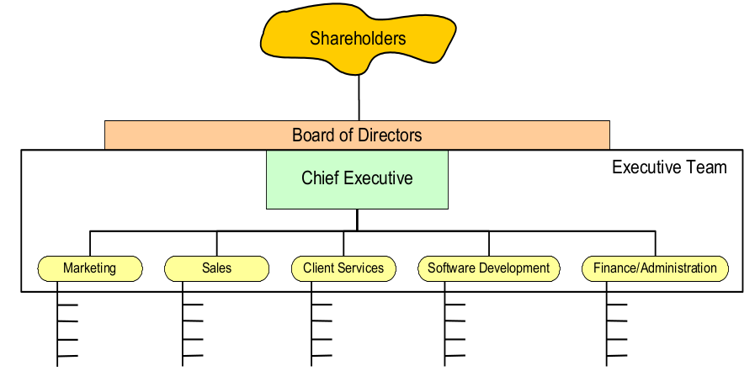
Software Development Companies

Slide 61
Software Development Companies
Shareholders :
owners of the company
elect the board of directors
Board of directors
Represent shareholder interests
Appoint oﬃcers, hire & advise CEO

Slide 62
Software Development Companies
Software Development Team
Product or Project Manager : is accountable for knowing the “who, what, where, when, and why of the software plan. A Project Manager in a software development team often deals with various crucial roles and responsibilities including:
Making a software plan.
Developing a schedule.
Planning a budget.
Executing it in a proper manner.
Supervise all team members

Slide 63
Software Development Companies
Software Development Team
Business Analyst / Analyst
Studies and gathers all information about the product, outline the target audience’s needs, and act as a bonding agent between the market/customer/end-users and engineers.
They analyze users’ behavior / concerns, and then compile recommendations on product enhancement and development

Slide 64
Software Development Companies
Software Development Team
Software Architect
Plays the role of a decision-maker when it comes to the internal arrangement of the software or software components in accordance with the product requirements and procured resources.
On the basis of business needs, architects outline technical and functional instruments required for product development.

Slide 65
Software Development Companies
Software Development Team
Software Developers / Programmers
These are people who code the software first-hand. For this, they use various programming languages, frameworks, and libraries.
Their job can include integration, technical documentation….

Slide 66
Software Development Companies
Software Development Team
UX Designers
They make sure that the browsing experience and features are accessible for users.
They also take care of all interface elements so that it’s natively clear where to click to sign in, or navigate across different pages

Slide 67
Software Development Companies
Software Development Team
Other roles:
QA Engineers
UI/Graphics Designer
Documentation Editor
Translators
Testers
…

